Slide 1
Team Tech Vi Kings
AI-Powered Entity Research and Risk Scoring System

Slide 2
Agenda
Introduction &
Architecture
Features
Demo
Acknowledgements

Slide 3
AI-Powered Entity Research and Risk Scoring System
A Retrieval Augmented Generative (RAG) AI/ML-driven platform that automates research, verification, and risk scoring of entities from multi-source transaction data

Slide 4
AI-Powered Entity Research & Risk Scoring
The main objective of this project is to develop a sophisticated AI/ML-powered system that automates entity research, verification, and risk scoring. By leveraging Generative AI, multi-source transaction data analysis, and automated workflows, we aim to enhance accuracy, reduce manual effort, and provide a robust risk evaluation framework. This solution will empower analysts with intelligent insights for informed decision-making.

Slide 5
What Happens After Transaction Submission?
Our AML system will perform these steps automatically
Entity Extraction
The system identifies organizations, individuals, and jurisdictions from your transaction.
Sanctions Screening
All entities are checked against global sanctions lists and PEP databases.
Entity Verification
Organizations are verified through corporate registries and global databases.
Risk Assessment
A comprehensive risk score is calculated based on all findings and evidence.
Report Generation
A detailed risk report is generated with supporting evidence and recommendations.

Slide 6
Risk Parameters Considered:
Category | Factor Checked | Why It Matters | Source
Sanctions | OFAC/UN/EU Sanctions List Match | Sanctioned entities are legally restricted and pose high ML/TF risk. | OPENSACTIONS API
Shell / Blacklisted Entities | Blacklist Association & Shell Company Indicators | Shell companies in blacklisted jurisdictions often facilitate ML/TF. | OPENCORPORATES
PEP/RCA Status | Politically Exposed Person (PEP) / Close Associate (RCA) | PEPs have power over public funds, increasing corruption risks. | OPENSACTIONS DATA
Miscellaneous | Additional Information about Entities | Helps verify PEP status and connections through knowledge graphs. | WikiData
FATF Jurisdiction | Country’s FATF Risk Classification (Blacklist/ GreyList) | High-risk jurisdictions have weak AML controls, increasing exposure. | FATF Official List
Adverse Media | Negative Reports or Criminal History | Negative media suggests involvement in financial crimes. | GDELT Project News API
Transaction History | Historical Transaction Data | Identifying patterns of illicit transactions over time. | Neo4J Graph-based data storage
Transaction Profile | Unusual or Structuring Transactions | Complex transactions can be used for money laundering. | LLM - Gemini

Slide 7
Final Output Fields in JSON
Field | Description
extracted_entities | Names of flagged individuals/entities.
entity_types | Type of entity (PEP, sanctioned entity, etc.).
risk_score | Final calculated risk score (0.0 - 1.0).
supporting_evidence | Justification for the score (FATF lists, media, etc.).
confidence_score | Reliability of the assessment.
reason | Main drivers for the risk score.

Slide 8
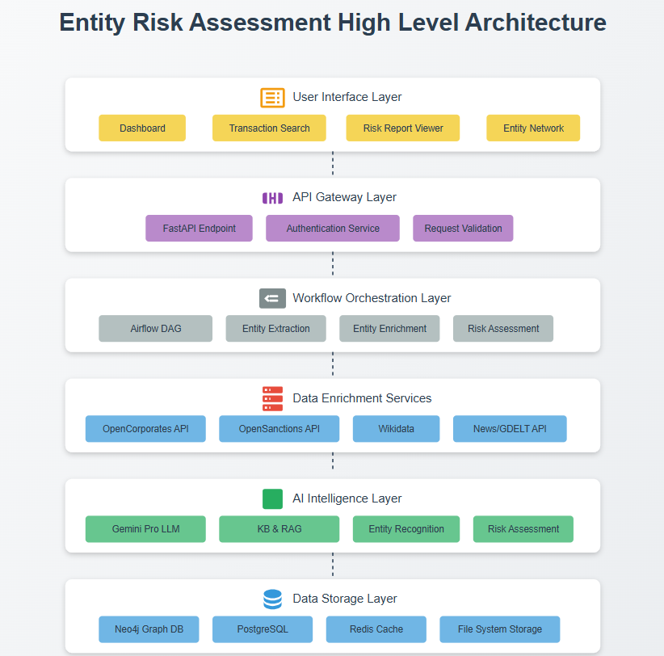
Architecture Diagram

Slide 9
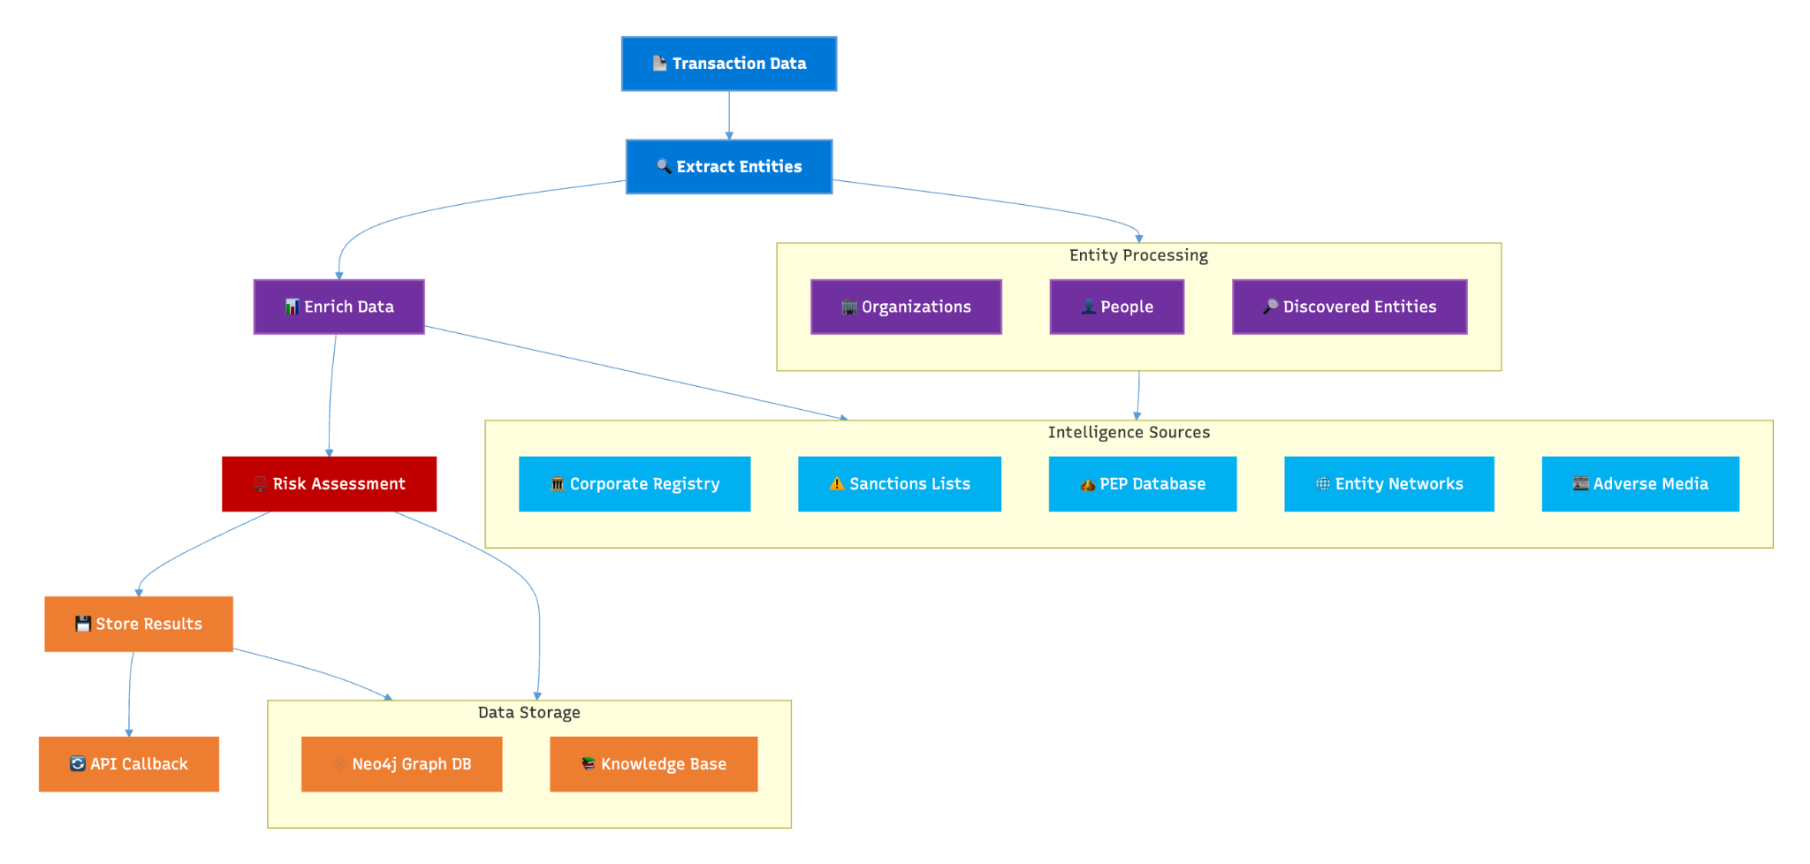
Process Flow

Slide 10
Features
Admin Dashboard Panel
Single / Bulk Transaction Uploads
Real-Time Knowledge Base
Detailed Analysis of Transactions with Supporting Evidence
Related Entities with Network Graph
Full Transaction History
Apache Airflow Integration
State-of-the-art Modern UI / UX with Mobile Responsiveness
BDD (Business Driven Development) Functional Testing

Slide 11
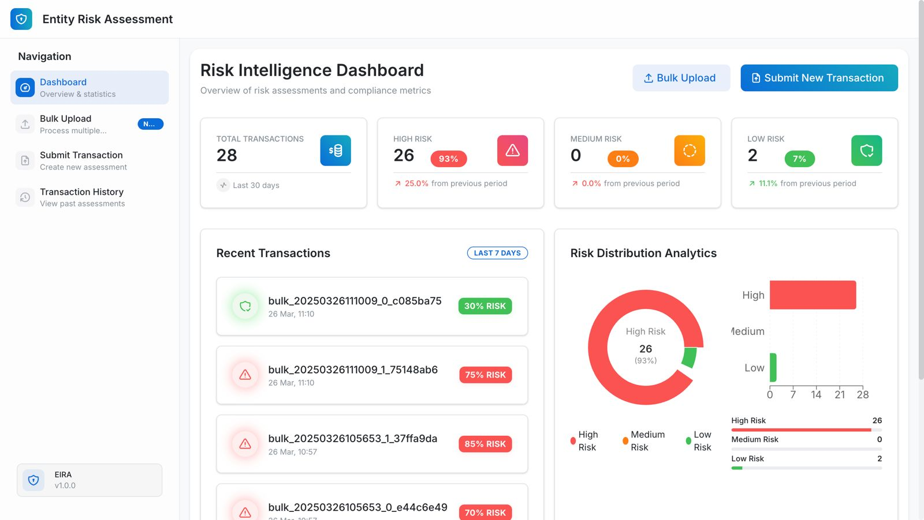
Screenshots

Slide 12
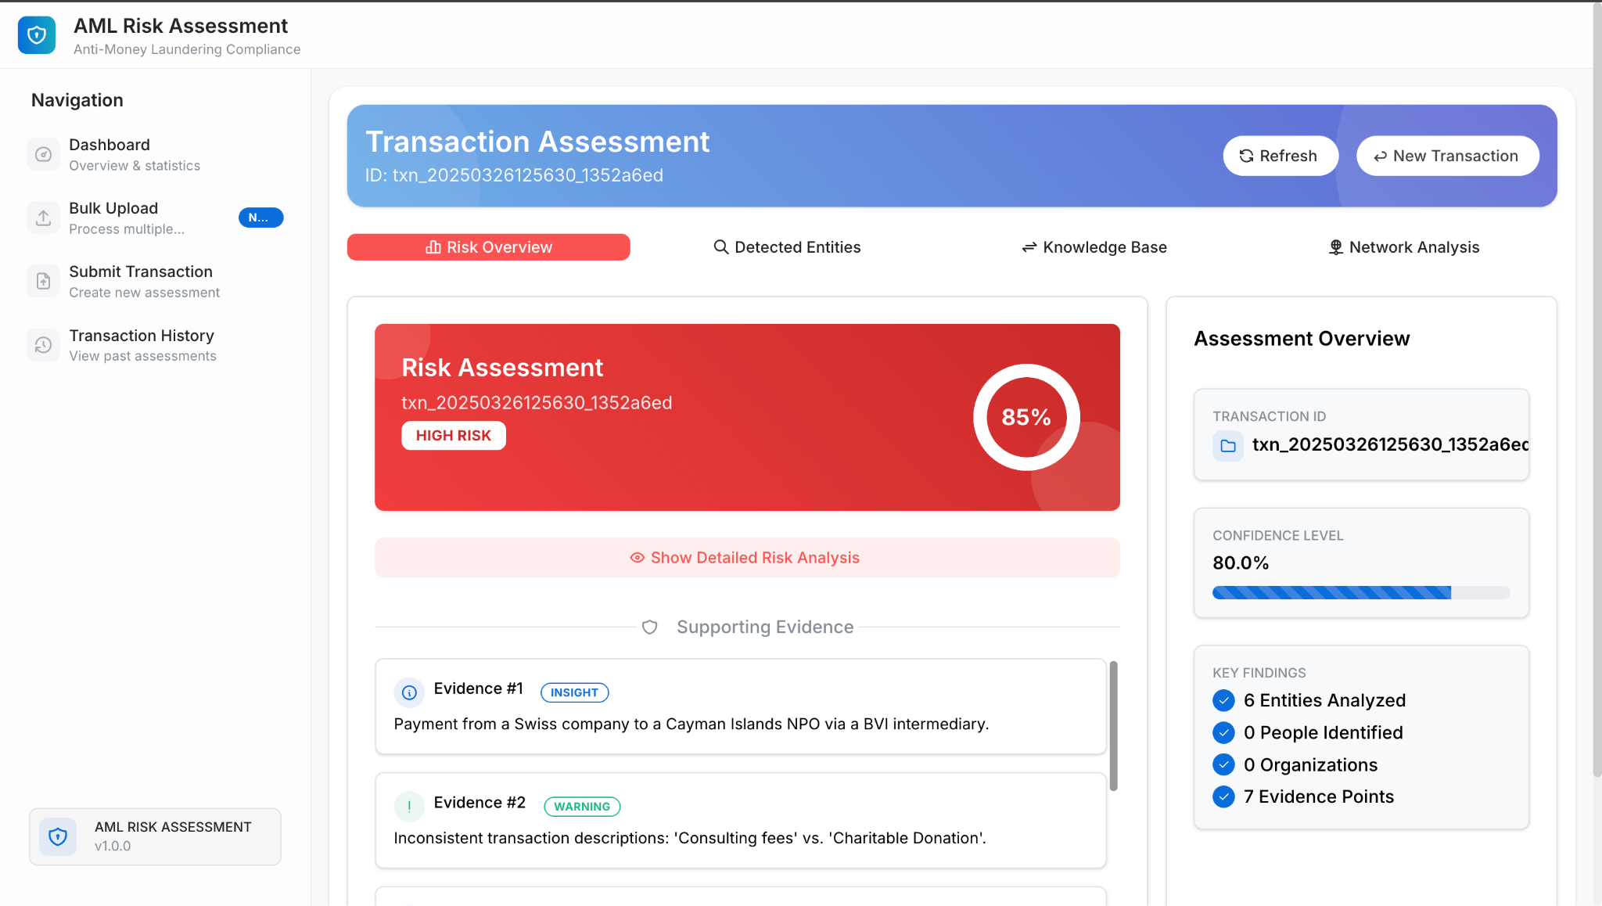

Slide 13
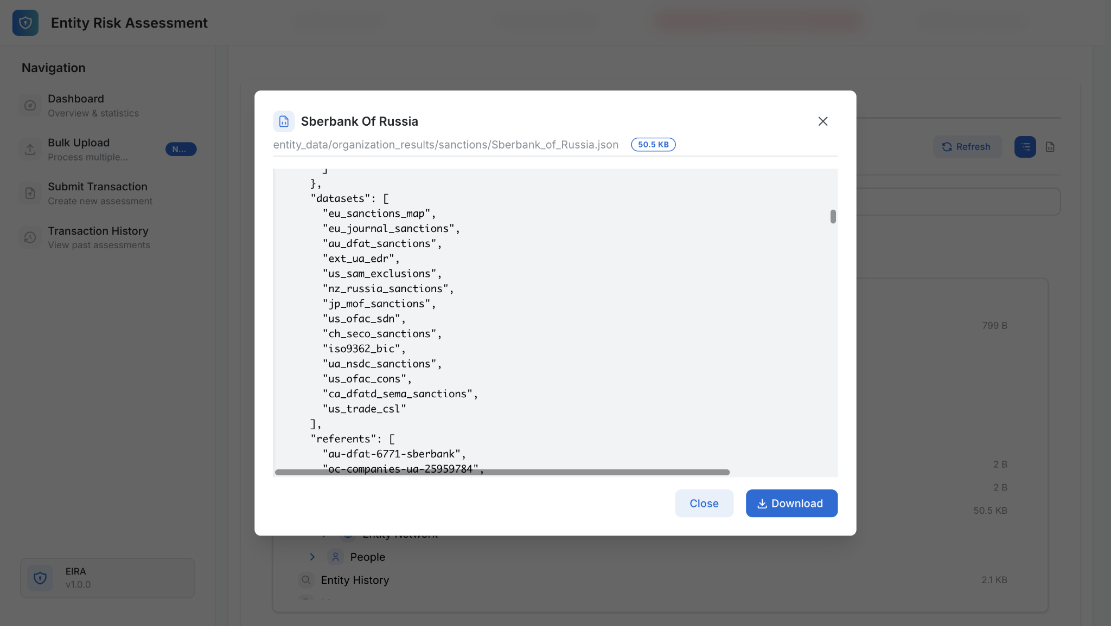

Slide 14
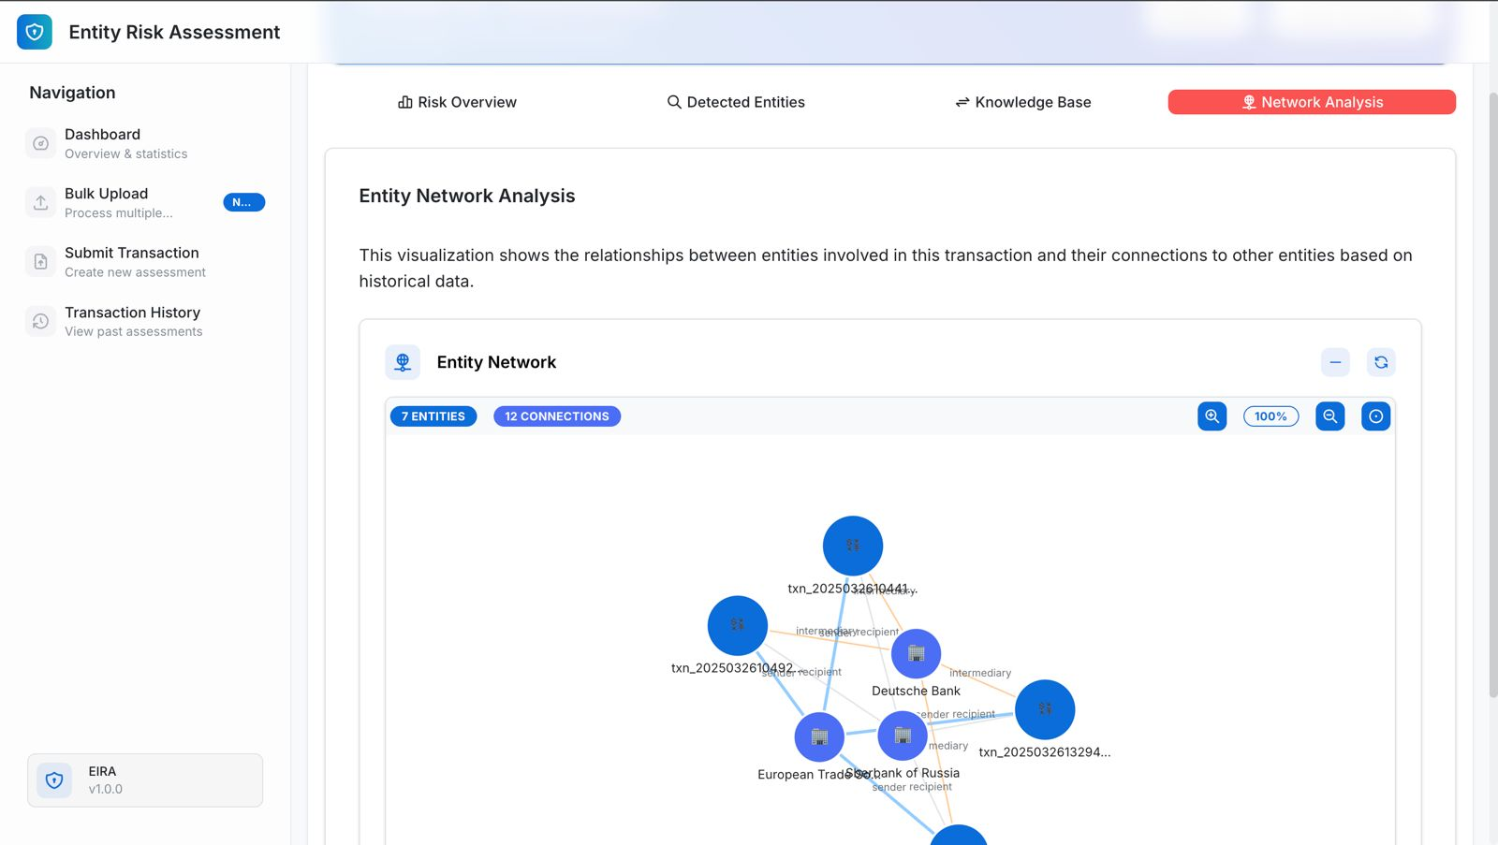

Slide 15
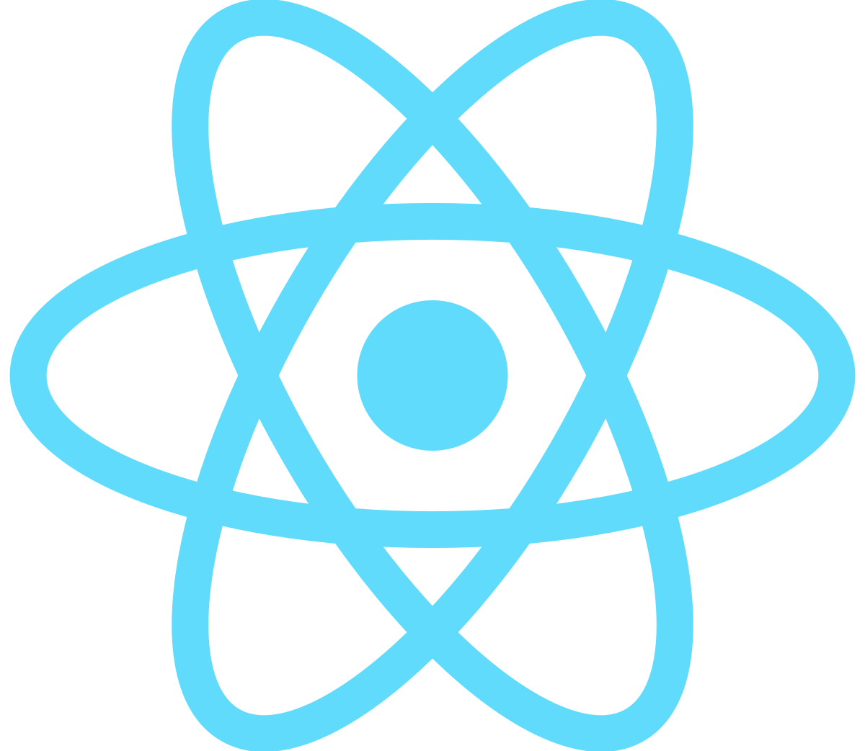
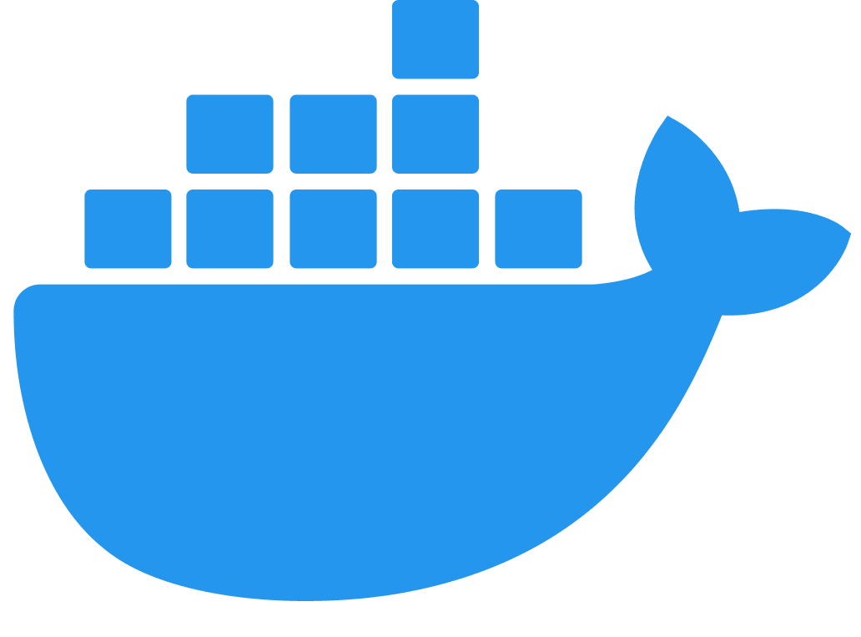


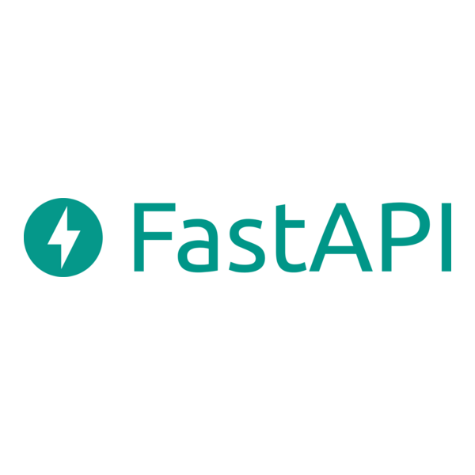
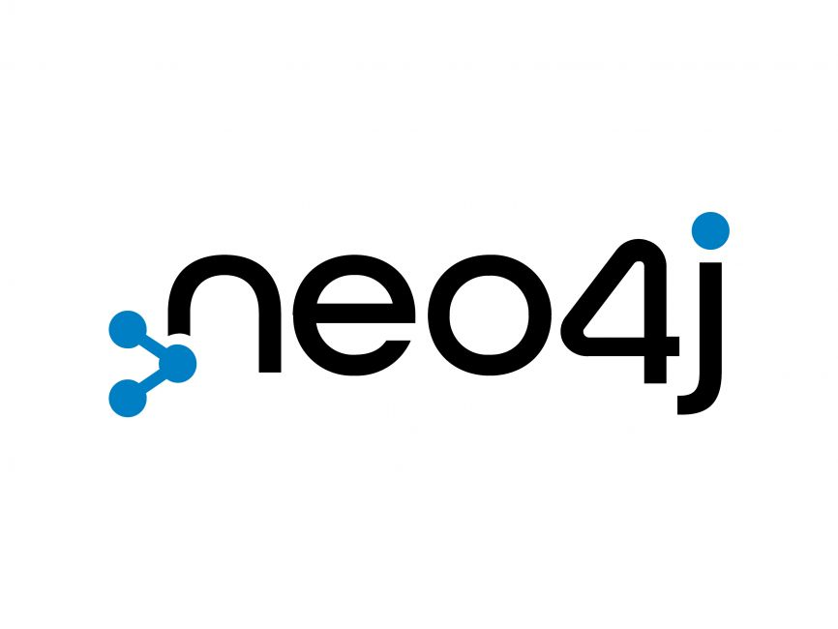
Tech Stack
React JS
Docker
Mantine UI
Fast API
Neo4j

Slide 16
Apache Airflow
To streamline and automate complex workflows, we leverage Apache Airflow, an advanced orchestration tool. Airflow enables scheduling, monitoring, and managing data pipelines efficiently, ensuring seamless execution of tasks across distributed environments. With its dynamic workflow management, businesses can improve reliability, traceability, and scalability of their processes.

Slide 17
Neo4j
Neo4j is a powerful graph database designed for handling complex relationships in data. By leveraging a flexible and scalable graph model, Neo4j enables efficient querying, pattern recognition, and deep insights across connected datasets.

Slide 18

Gemini
Gemini is a family of large language models (LLMs) developed by Google DeepMind, designed for advanced reasoning, multimodal understanding, and code generation. It supports text, images, audio, and video processing, making it versatile for AI-powered applications. Gemini models are optimized for efficiency, offering various sizes for different use cases, from mobile devices to high-performance AI systems.

Slide 19





Our Team
Sailesh Swaminathan
Pradeep S
Indresh P
Rajakumar S
Shri Hari L

Slide 20
Thank you!
For making this hackathon one of the best experiences of our life 😊

